Slide 1

Xamarin.Forms 5.0 Az Kod Çok İş
Yiğit Özaksüt
@ozaksuty
Microsoft MVP & MCT

Slide 2
New in Visual Studio
XAML Hot Reload 2.0: Faster than ever, now with UWP support and a Live Visual Tree
Xamarin Hot Restart for iOS improvements
Visual Studio 2019 16.8

Slide 3
Last Year in Xamarin.Forms
Accessibility
BindableLayouts
Brushes (Solid & Gradient)
C# UI Extensions
CarouselView
Character Spacing
CheckBox
Drag & Drop
Embedded Fonts
Expander
FontImageSource
Gif Animations
HTML Label
IndicatorView
Maps
MediaElement
Modal Prompts
Mult-Binding
RadioButton
RefreshView
RelativeSource Binding
Shapes, Paths, Clipping
Shell Modals
SourceLink
SwipeView
VisualStateManager
WKWebView
++
Notes:
https://devblogs.microsoft.com/xamarin/xamarin-forms-shapes-and-paths/

Slide 4
Xamarin Community Toolkit
Behaviors
Converters
Effects
Extensions
Helpers
ObjectModel
Views
https://github.com/xamarin/xamarincommunitytoolkit

Slide 5
Xamarin.Forms 5.0 Preview
Brushes – solid and gradient
CarouselView + IndicatorView
Drag & Drop gestures
RadioButton + ControlTemplates
Shapes & Paths + Clipping
SwipeView

Slide 6
DEMO

Slide 7
Future Focus
Xamarin vNext - .NET MAUI
Mobile in .net &
Slim Renderers aka Handlers
HostBuilder
Templated visual styling to support Cupertino, Fluent UI, Material
C# Hot Reload
Single Project

Slide 8
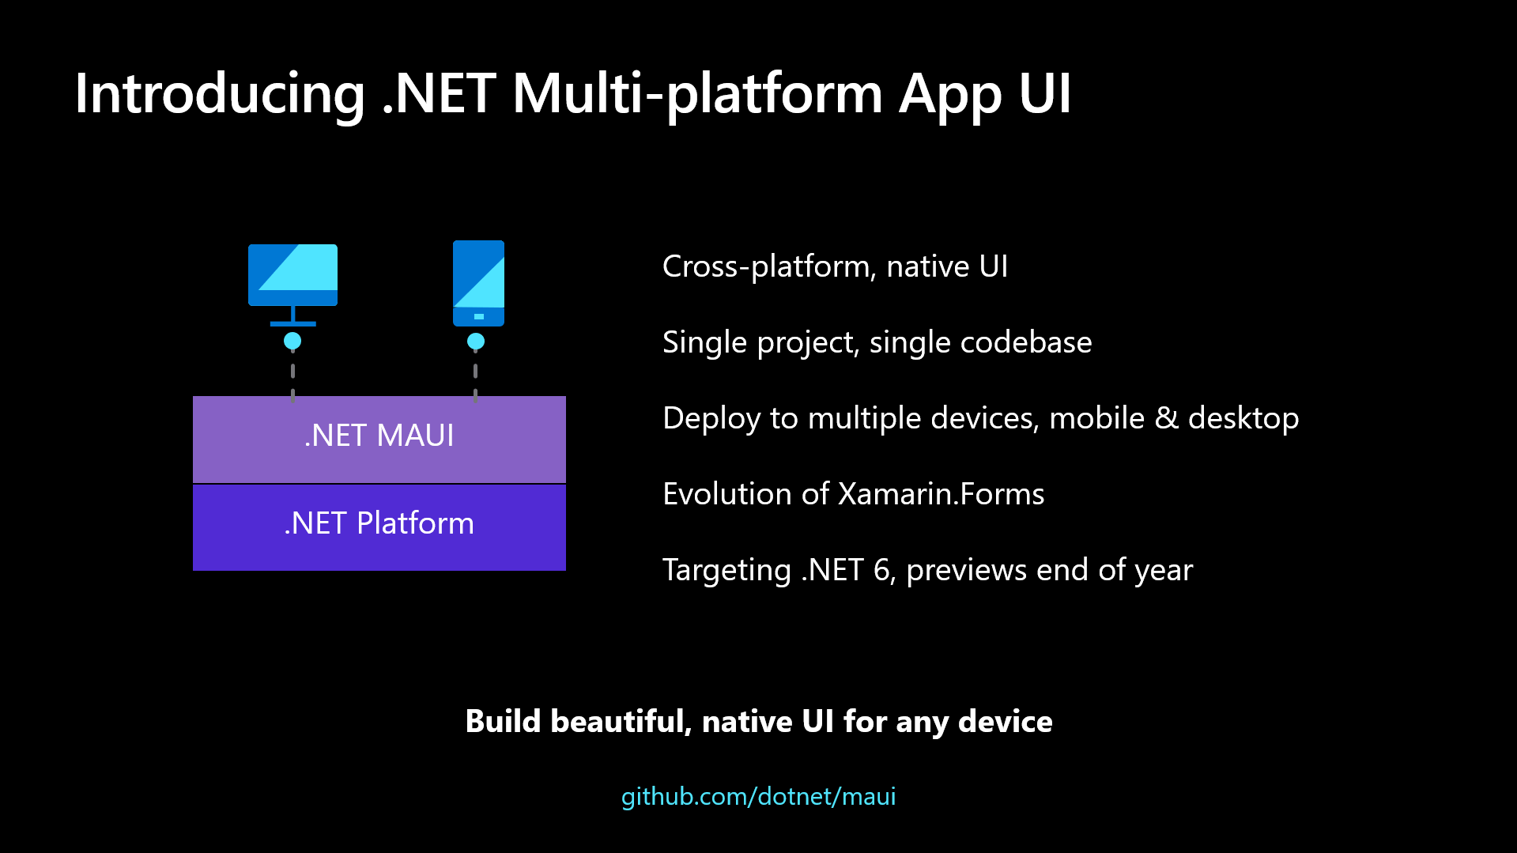
MAUI
Notes:
Xamarin.iOS ve Xamarin.Android .NET 6'ya dahil edilecek ve sırasıyla .NET for iOS ve .NET for Android olarak yeniden isimlendirilecekler. Ayrıca CLI desteği ile geliştirme daha hızlı bir hale getirilecek.

Slide 9
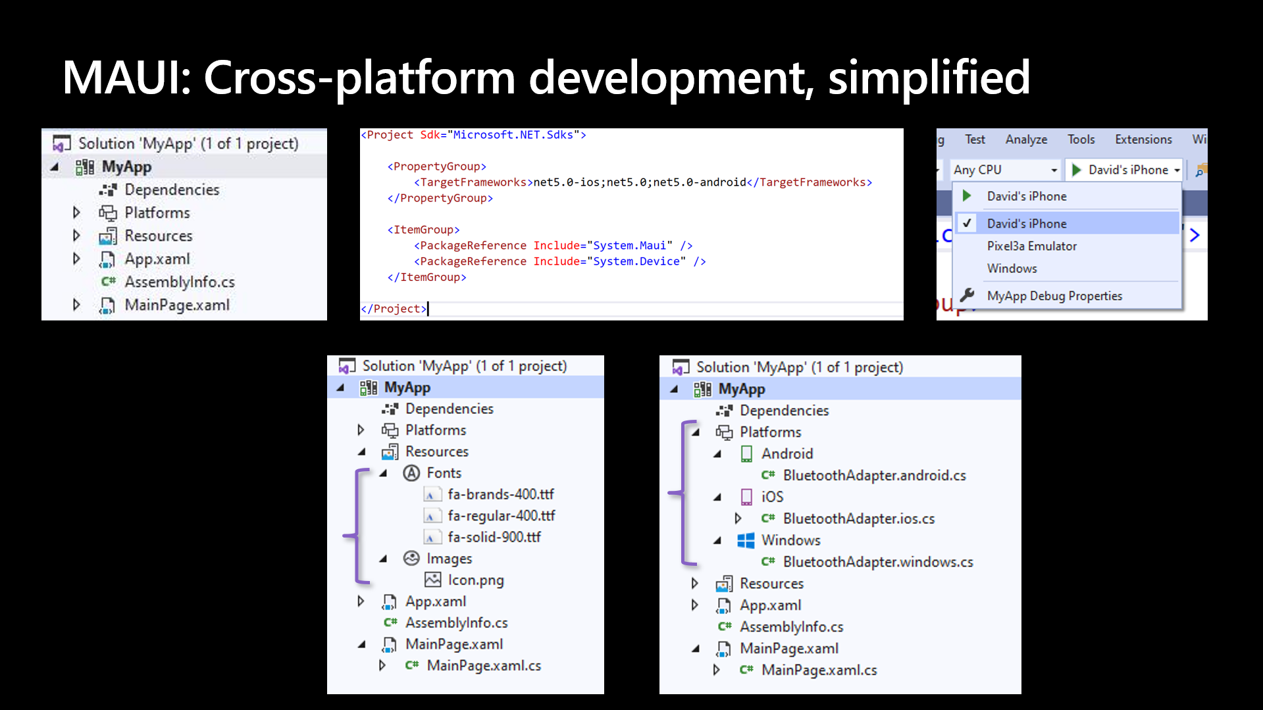
MAUI

Slide 10
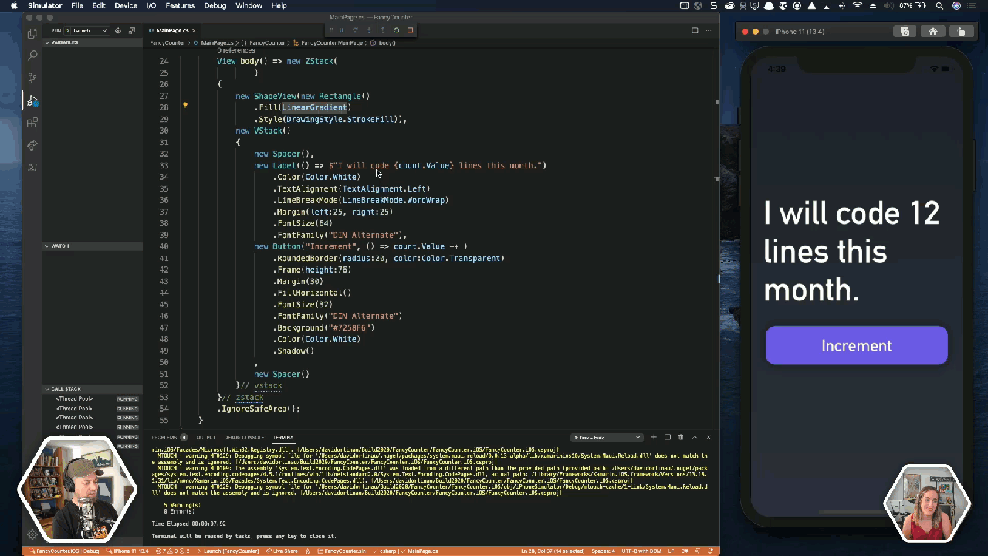
MAUI
Notes:
Halihazırda bildiğimiz ve kullandığımız üzere XAML-MVVM ikilisi MAUI’da da kullanılmaya devam edecek. Buna ek olarak MVU(Model-View-Update) ve hatta Blazor desteği de gelecek.

Slide 11
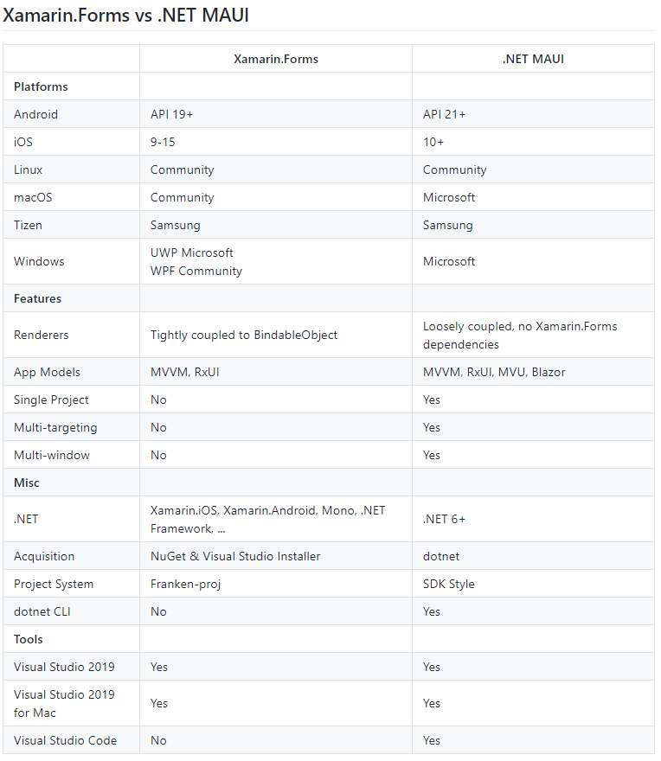
XF VS MAUI

Slide 12
Thanks

